Slide 1
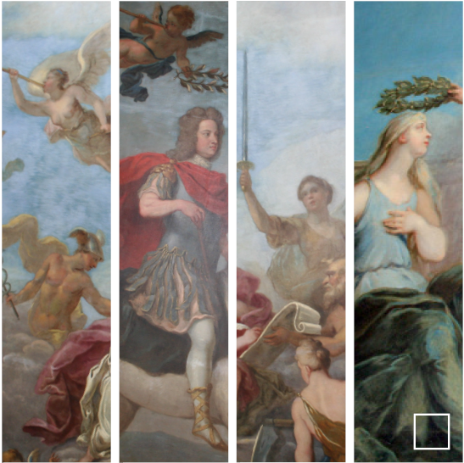

Slide 2
DISCRIMINATION LAW UPDATE TARA O’HALLORAN 6 December 2017 Old Square Chambers

Slide 3
Burden of Proof?
Igen v Wong [2005] I.R.L.R. 258
STAGE 1: Claimant must show a “prima facie” case they had suffered detriment because of a protected characteristic.
STAGE 2: If established, burden passes to employer to show non-discriminatory reason for treatment.
Notes:
Appeared to be settled position
Endorsed by Supreme Court in Hewage v Grampian Health Board [2012] ICR 1054: see para 25 Lord Hope

Slide 4
S136 EA 2010
“(2) If there are facts from which the court could decide, in the absence of any other explanation, that a person (A) contravened the provision concerned, the court must hold that the contravention occurred.
(3) But subsection (2) does not apply if A shows that A did not contravene the provisions.”

Slide 5
Efobi v Royal Mail Group Limited UK EAT/0203/16, 10 August 2017
Laing J - No burden on Claimant
Tribunal must consider all the evidence at the end of the hearing and decide whether or not there are facts, absent any other explanation, from which discrimination can be found.

Slide 6
Para 78 – Laing J in Efobi
“Section 136...requires the ET to consider all the evidence, not just the Claimant’s, and because it is explicit in not placing any initial burden on the claimant. The words ‘facts’ in section 136(2) rather than ‘evidence’ shows, in my judgment, that Parliament requires the ET to apply section 136 at the end of the hearing, when making its findings of fact. It may therefore be misleading to refer to a shifting of the burden of proof, as this implies, contrary to the language of section 136(2), that Parliament has required a claimant to prove something. It does not appear to me that it has done.”

Slide 7
Ajayi Ayodele v CityLink Ltd v Paul Napier [2017] EWCA Civ 1913
Lord Justice Singh: interpretation of s136 by Laing J in Efobi is wrong and should not be followed.
Burden of proof is on Claimant.

Slide 8
STAGE 1/FACTS:
Claimant must establish a prima facie case of discrimination.
Tribunals entitled to take into account facts adduced not only by Claimant but also by Respondents before determining whether prima facie case made out.
Notes:
In this case – argued that ET had erred by considering facts adduced by the Respondent in the first stage fact inquriy. That ET should have only considered these in the second stage.

Slide 9
STAGE 2/EXPLANATION:
If Tribunal prepared to draw inference of discrimination from facts, then burden passes to Respondent to provide an explanation for treatment.
It is only the explanation from the employer that cannot be considered at the first stage of the analysis.
Notes:
N.B. to recognise clear distinction between “facts” and “explanation”.: see Elias J in Laing v Manchester CC [2006] ICR 1519.
Facts on behalf of R can be considered. Although facts and explanations are clearly related they are not to be confused.

Slide 10
Direct v Indirect Discrimination
2 ECJ cases involving Muslim women dismissed for wearing headscarves.
Illustrate how classification of claim as direct or indirect discrimination affects liability.
Notes:
Even where factual circumstances somewhat similar.

Slide 11
Cont’d
Indirect discrimination – can be justified.
Direct discrimination – no justification unless it can be shown that there is a ‘genuine occupational requirement’ for the treatment.
Notes:
2 ECJ cases involving Muslim women dismissed for wearing headscarves at work.

Slide 12
Achbita v G4S Secure Solutions NV [2017] IRLR 466
Secretary dismissed for wearing an Islamic headscarf. Belgian employer had policy of neutrality such that any visible symbols of political, philosophical or religious beliefs were banned.
ECJ: policy of neutrality “must be considered legitimate” – question of proportionality left for the national court.
Notes:
The rule thus treated all employees in the same way, notably by requiring them, generally and without any differentiation, to dress neutrally.
such an internal rule did not introduce a difference of treatment that was directly based on religion or belief, for the purposes of the directive. However, the Court observed that it was not inconceivable that the national court might conclude that the internal rule introduced a difference of treatment that was indirectly based on religion or belief, should it be established that the apparently neutral obligation it encompassed resulted, in fact, in persons adhering to a particular religion or belief being put at a particular disadvantage

Slide 13
Bougnaoui and another v Micropole SA [2017] IRLR 447
Design engineer told not to wear headscarf when she next visited a particular client.
Classified as an act of direct discrimination.
ECJ: requesting employee to have “no veil next time” was not a matter that could amount to a genuine and determining occupational requirement.
Notes:
The concept of a 'genuine and determining occupational requirement' referred to a requirement that was objectively dictated by the nature of the occupational activities concerned or of the context in which they were carried out. It could not, however, cover subjective considerations, such as the willingness of the employer to take account of the particular wishes of the customer [para 40]
Whilst the instructions had the same impact on the employees – evidence that fixing of liability is different depending on the categorisation as direct or indirect discrimination.

Slide 14
Essop v The Home Office [2017] UKSC 27
Statistical evidence indicated that BME and older candidates (+35 yrs) looking for promotion were more likely to fail the Core Skills Assessment.
Candidates alleged indirect discrimination but could not say why assessment put them at a disadvantage.
Notes:
Significant judgment on 2 indirect discrimination cases heard together, handed down by Supreme Court in April 2017.
to higher grades within the Home Office

Slide 15
Naeem v Secretary of State for Justice [2017] UKSC 27
Employee was a Muslim prison chaplain. The Prison Service pay scheme related pay to length of service.
Average pay for Muslim chaplains was lower than that for Christian chaplains; Muslims had only been employed since 2002, whereas many Christians had started their employment earlier so were higher on the pay scale. Alleged indirect discrimination.

Slide 16
Key Question?
Does indirect discrimination (s19) require the reason for the disadvantage suffered by the relevant group to be established?

Slide 17
Court of Appeal said yes
Claimants must show why the provision in question has an adverse impact on people sharing a protected characteristic.
In Naeem, Underhill LJ said it was necessary to look at the material cause of the disparity: in this case, there had been no need for iman’s before 2004 given the number of muslim prisoners in the system.

Slide 18
Supreme Court said no
Hale JSC: no requirement to show why the provision, criterion or practice puts one group at a disadvantage compared to others.
The essential element is a causal connection between the PCP and the disadvantage suffered, not only by the group, but also by the individual. This may be easier to prove if the reason for the group disadvantage is known but that is a matter of fact, not law.
Notes:
need for proof of the reason why the complained of provision put the affected group at a disadvantage, only that there was a causal connection between that provision, namely the test, and the disadvantage suffered, namely, in the case of the group the greater likelihood of failure and in the case of each individual claimant an actual failure, such potential and actual disadvantage being the same for the purpose of showing the necessary shared disadvantage between group and individual;
no need to show that the reason for the provision's disparate impact was something peculiar to the claimant's religion or race;

Slide 19
Age Discrimination
Abercrombie & Fitch Italia Srl v Bordonaro [2017] IRLR 1018
Fries v Lufthansa CityLine GmbH [2017] IRLR 1003

Slide 20
Cont’d
Abercrombie: dismissal of a worker engage on an on-call contract once he reached 25.
Italian law: such contracts not permitted for workers 25 – 45 years old.
Rationale: promotes flexibility in the job market, facilitates youth employment and provides young people with a first opportunity to access the employment market.

Slide 21
Cont’d
Fries: compulsory retirement of a commercial airline pilot at age 65.
Rationale: ensuring safety / international standards.

Slide 22
ECJ Held
Aims pursued were undoubtedly legitimate.
Provisions were “appropriate for achieving the objective” in question and were appropriate and necessary.

Slide 23
Thank you
London
10 - 11 Bedford Row
London WC1R 4BU
DX 1046 London / Chancery Lane
T 020 7269 0300
E clerks@oldsquare.co.uk
W oldsquare.co.uk
@OldSqChambers

